Slide 1
Customized Corporate Gifts in India: Personalization Trends
and Ideas
https://growthigo.com/

Slide 2
Growthigo
The corporate gift market developed into a trend where businesses select individualized corporate gifts to establish lasting business connections. A personalized gift approach enhances present giving because it creates feelings of appreciation among recipients. Creative corporate presents have become increasingly prominent within the Indian market since companies seek specific meaningful gifting solutions. This essay will investigate current personalization concepts along with innovative corporate present ideas which deliver real impact.

Slide 3
Why Personalization Matters in Corporate Gifting
Growthigo
The customized nature of corporate gift items enables businesses to secure better relationships between employees and both clients and business partners. Customized gifts help organizations obtain better brand visibility and deliver useful items that remain memorable. Personalization through name etching and logo insertion and custom corporate gift set creation bestows gift packages with exclusive status to recipients.

Slide 4
Popular Trends in Customized Corporate Gifts
Growthigo
1. Engraved and Monogrammed Gifts
Engraved pens and monogrammed wallets and personalized notebooks represent popular choices which businesses use as corporate gifts for employees and clients. Such elegant and usable presents leave a lasting impact in professional settings.
2. Branded Tech Accessories
Businesses choose branded wireless chargers alongside Bluetooth speakers and customized USB drives as premium corporate presents because technology manages daily operations. Business personnel benefit from these items because they combine utility with fashionable design aspects.

Slide 5
Growthigo
3. Eco-Friendly Personalized Gifts
The gifting industry has sustainability as one of its main emerging trends. The market now features corporate gifting companies that supply customized bamboo office supplies together with reusable drinking containers and plant-growing packages for customers. Unique corporate presents demonstrate that a company cares about environmental sustainability.
4. Luxury and High-End Personalized Gifts
Executives with high-profile statuses receive exclusive luxury items such as customized leather bags together with premium watches and premium gift boxes. Corporate gifting companies in India continue to expand their VIP client attraction service by delivering customized premium hampers.

Slide 6
Best Customized Corporate Gift Ideas
Growthigo
Business institutions should supply workers with three types of employee gifts which include marked mugs together with trophies and branded attire.
The client entertainment department provides custom hampers along with premium writing tools and monogrammed leather accessories.
Organizations prefer gift hampers that contain a selection of snacks and beverages along with company-branded labels.
Corporate gift ideas for customers like personalized keychains, reusable bags, and digital gift cards.
The range of inexpensive corporate presents includes distinctive notebooks paired with individualized calendars displayed in sustainable tote bags.

Slide 7
Conclusion
Growthigo
Organizations trying to establish stronger relationships with their stakeholders now find personalization to be a central business trend for corporate gifting providers. Different approaches to personalization help businesses elevate their gifting plans whether they search for corporate gifts India or corporate gift ideas for clients or customized employee gifts. The selection of a reliable corporate gift supplier guarantees corporate gifting experiences with excellent quality that create meaningful and lasting meaningful memories.

Slide 8
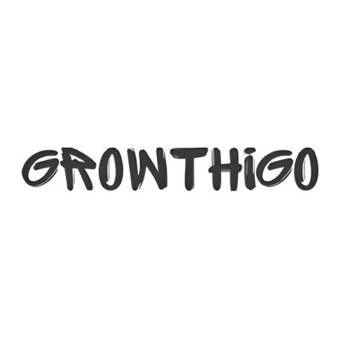
Contact us
Growthigo
About
We believe in making gifting an art that strengthens relationships and creates lasting memories. From creative gift selection to seamless delivery, we handle everything with passion and dedication.
Address
Office No – 703, ANP Landmark, Sr. no. 89, Bhumkar Chowk, Hinjawadi – Wakad Rd, Pune, Maharashtra 411057
Phone
+91 8386832969
Email
info@growthigo.com
Growthigo

