Slide 1
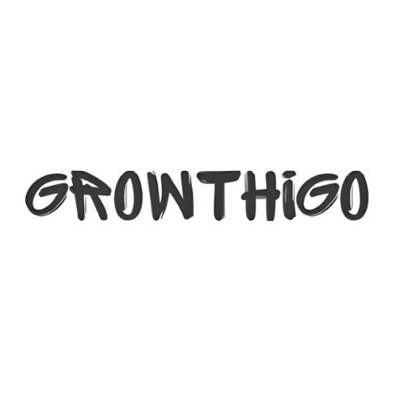
Best Corporate Gift Sets to Elevate Your Brand Image
https://growthigo.com/

Slide 2
Growthigo
Modern business relationships benefit significantly from select corporate gift approaches since these gestures foster employee and client and business partner attachments. Nice corporate gift collections demonstrate both gratitude and strengthen brand memory while creating dependable client relationships. Selecting gifts with high quality and meaningful corporate items will produce lasting positive effects on recipients.

Slide 3
Why Corporate Gift Sets Matter
Growthigo
Company values and meticulous detail emerge from corporate gift set that have received precise selection. The choice of corporate gift ideas provides benefits to both employees and clients because it builds work relationships and raises team morale and sustains client loyalty. Companies possess multiple choices between custom and luxury corporate gifts because they need diverse corporate gifting approaches for various clientele.

Slide 4
The Selection of Valuable Corporate Gift Packages
Growthigo
Premium Executive Gift Sets
Businesses should give top-level executives and valuable clients premium corporate gifts that combine luxury leather organizers and upscale pens and branded products to create an exclusive experience. The delivery of luxury corporate presents achieves dual purposes by presenting appreciation while maintaining and improving a company's reputation for providing premium service.
Customized Corporate Gift Sets
Using personalized gifts enhances the touch of affection in a present. Customized corporate gifts india include personalized notebooks with inscriptions and monogrammed digital devices and customized drinkware collections. The gifts enhance recipient value appreciation while simultaneously raising brand recognition.

Slide 5
Growthigo
Corporate Gift Hampers
When going for a corporate gift, hamper recipients find the carefully selected items an ideal present especially for special festive times and important milestones. Business hampers containing sophisticated foods and premium chocolates and elegant skin care items transform into luxurious present options.
Practical and Budget-Friendly Gift Sets
Businesses interested in corporate gifts under 500 rupees should choose useful presents that combine stylish notebooks with office necessities and sustainable accessories. Well-priced corporate presents for staff members and clients enable businesses to stay memorable while respecting their financial constraints.

Slide 6
Growthigo
Unique and Innovative Gift Sets
Businesses who want to stand apart should choose corporate gifts which include unique items such as smart gadgets together with customized planners or sustainable lifestyle products. Thoughtful and creative gift solutions create lasting strong impressions that demonstrate a business's dedication to innovative solutions.

Slide 7
Choosing the Right Corporate Gift Supplier
Growthigo
To achieve both quality standards and customization businesses need to partner with accomplished corporate gifting companies. A reliable corporate gift supplier enables businesses to select from affordable sets to match their brand style using the best corporate gifts. Indian corporations should consider working with local corporate gifting companies in India which offer customized products from home-based suppliers.

Slide 8
Conclusion
Growthigo
The strategic deployment of corporate gifts helps build company value combined with developing professional business connections. Your corporate gift boxes and hampers should be chosen to fit any client corporate gift ideas or employee corporate gift ideas or promotional gift needs as appropriate corporate gift boxes will enhance your brand image. Businesses can achieve memorable impactful and brand-representative gifts by selecting appropriate gift sets.

Slide 9
Contact us
Growthigo
About
We believe in making gifting an art that strengthens relationships and creates lasting memories. From creative gift selection to seamless delivery, we handle everything with passion and dedication.
Address
Office No – 703, ANP Landmark, Sr. no. 89, Bhumkar Chowk, Hinjawadi – Wakad Rd, Pune, Maharashtra 411057
Phone
+91 8386832969
Email
info@growthigo.com
Growthigo

