Slide 1
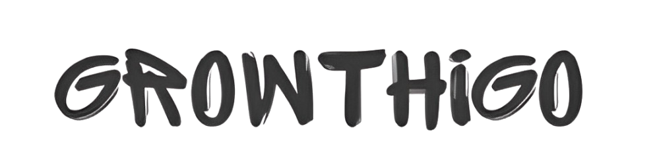
The Rise of Customized Corporate Gifts in India: Trends and Insights
https://growthigo.com/

Slide 2
Corporate gifting has undergone immense growth over the last few years, with companies now on the lookout for corporate gifts as a means to develop good relationships with employees, clients, and stakeholders. The demand for customized corporate gifts in India has gone up enormously as organizations look upon offering thoughtful and personalized gifting options for better brand recognition and loyalty. This blog delves into trends and insights that convey a boost in popularity for customized corporate gifts in India and strategizes how companies can exploit them.
Increased Demand for Customized Corporate Gifts
Personalization is the driving force behind today's gifting trends. Gone are the days of generic gifting that fails to connect with the target audience. Corporate gifts nowadays represent brand ethos and customer values. The addition of names, logos, or customized designs on corporate gifts enhances their value, making a corporate gift more meaningful and powerful.

Slide 3
Trends in Corporate Gifting
1. A Shift to Premium and Luxury Gifts
Increased competition has sparked a trend among companies for investing in luxury corporate gifts to impress high-value clients and employees. Gifts that reflect an aura of class and uniqueness include leather accessories, high-tech gadgets, and gourmet gift baskets.
2. Eco-Friendly and Sustainable Corporate Gifts
Focusing increasingly on sustainability, companies are now opting for corporate gift alternatives that are sustainable, like reusable bottles, bamboo notebooks, and organic gift hampers. These gifts lower the environmental footprint while appealing to conscious consumers.

Slide 4
3. Handpicked Corporate Gift Hampers
Custom-made corporate gift hampers are trending, and companies can pick and choose their option mix for the recipient. The baskets may include gourmet food objects or wellness kits, thus making them versatile enough to be used for special occasions.
4. Inexpensive Yet Thoughtful Gift Ideas
Affordable companies are choosing gifts below Rupees 500 that appeal nicely to the receiver. These may include items such as personalized stationery.
5. Employee-Centric Corporate Gifts
Companies also focus on corporate gifts for employees that promote motivation and job enrichment. Popular corporate gift ideas for employees are personalized water bottles, tech accessories, and wellness kits.

Slide 5
Ideal Corporate Gift Supplier
It is of utmost importance for a corporate gift supplier to provide good quality products and on-time delivery. Top corporate gifting firms in India offer a confluence of the best corporate gifts, varying from categorized preferences to varying budgets. Companies need to ensure that the supplier they choose gives options for customization, bulk order delivery, and timely service.
Corporate Gift Ideas for Clients and Customers
While selecting corporate gifts for clients, companies should focus on utility and elegance. Innovation in branded tech accessories, elegant office organizers, premium drinkware, and personalized diaries and planners top corporate gift ideas for clients.
Likewise, ditching corporate gifts for customers around appreciation and brand recall; custom T-shirts, branded tote bags, and gourmet gift boxes are popular.

Slide 6
Presentation Counts: Corporate Gift Boxes and Sets
Good packaging of a gift adds spice to the recipient's experience. Going for stylish corporate gift boxes or a painstakingly curated corporate gift set adds gloss and makes them extra special and memorable.
Conclusion
The rise of custom corporate gifts in India is a reflection of the change in gifting culture toward a thoughtful, personal, and premium approach to gifting solutions. Whether one is choosing unique corporate gifts, eco-friendly corporate gifts, or premium corporate gifts, businesses should remain focused on quality and relevance if they aim to make a lasting impact. With the right corporate gifting companies, organizations could strengthen relations and elevate brand presence via the effectiveness in their gifting strategies.

Slide 7
Contact us
Curated Selection: Explore a wide variety of corporate gifts designed for clients and employees, offering thoughtful and meaningful selections for every occasion.
Customization Options: Personalize your gifts with branding and messaging options, creating memorable experiences that strengthen client and employee relationships.
https://growthigo.com/
Office No – 703, ANP Landmark, Sr. no. 89, Bhumkar Chowk,Hinjawadi – Wakad Rd, Pune, Maharashtra 411057
Phone : 77092 80369
Email: Bhavesh@growthwayadvertising.com

